Slide 1
Scheduling
MAN
August 2015

Slide 2
Scheduling
When more than one process is ready to run, but only one CPU is available, a choice is to make
Part of OS that does it is scheduler
The algorithm it uses is scheduling algorithm

Slide 3
Scheduling
Efficiency is needed as process switching is costly:
Switch from user mode to kernel mode
State of current process need to be saved
Memory map may be saved
A process is selected
MMU to be reloaded with memory map of new process
New process is started

Slide 4
Importance of Scheduling
Good scheduling algorithms can make a big difference
Resource utilization
Perceived performance & User satisfaction
Meeting other system goals (e.g., important tasks being taken care of immediately)

Slide 5
Process Behavior
Processes usually alternate bursts of computing with I/O requests.
CPU burst: the amount of time the process uses the processor before it is no longer ready
I/O in this sense is when a process enters the blocked state waiting for an external device to complete its work

Slide 6
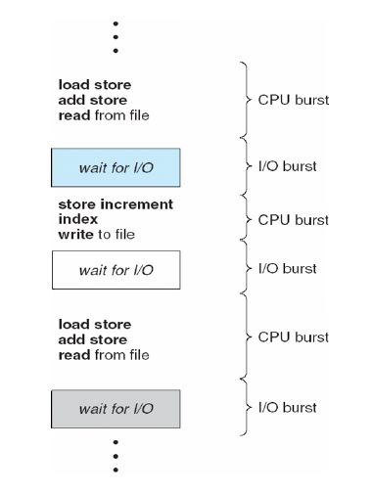

Slide 7
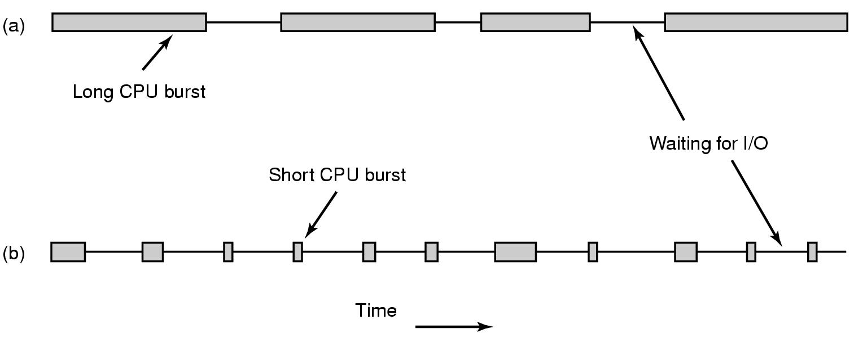
Process: Compute and I/O-bound
a CPU-bound process (data encryption/decryption, multimedia encoding)
Spend most of the time computing
Long CPU bursts => infrequent I/O waits
an I/O bound process (shell waiting for user commands)
Spend most of the time waiting for I/O
Short CPU bursts => frequent I/O waits
Key factor is the length of CPU burst not the length of the I/O burst

Slide 8
Process: Compute and I/O-bound
As the CPUs get faster, processes tend to get more I/O bound: WHY?
If a I/O bound process is ready, it should get a chance quickly.
Increase resource utilization

Slide 9
When to Schedule
When a new process is created:
Parent or child? Both are Ready
which one to run?
When a process exits:
One of the ready processes should be run
When a process blocks: Another process has to be selected to run
Blocking may occur for:
I/O
Semaphore

Slide 10
When to Schedule
When an I/O interrupt occurs:
In case of an interrupt of an I/O device having completed its work, some blocked process may now be ready
If a h/w clock provides periodic interrupt: A scheduling decision can be made at each (or kth ) clock interrupt

Slide 11
Preemptive & Non-preemptive
Classification of Scheduling Algorithm depending on dealing with clock interrupt
Non-preemptive: Picks a process to run and lets it run until it blocks or voluntarily releases the CPU. In effect at each clock interrupt, no scheduling is done.
Preemptive: Picks a process and lets it run for a maximum of some fixed time. If still running, it is suspended and another is picked.
Preemptive scheduling requires having a clock interrupt occur at the end of the time interval to give control of the CPU back to the scheduler

Slide 12
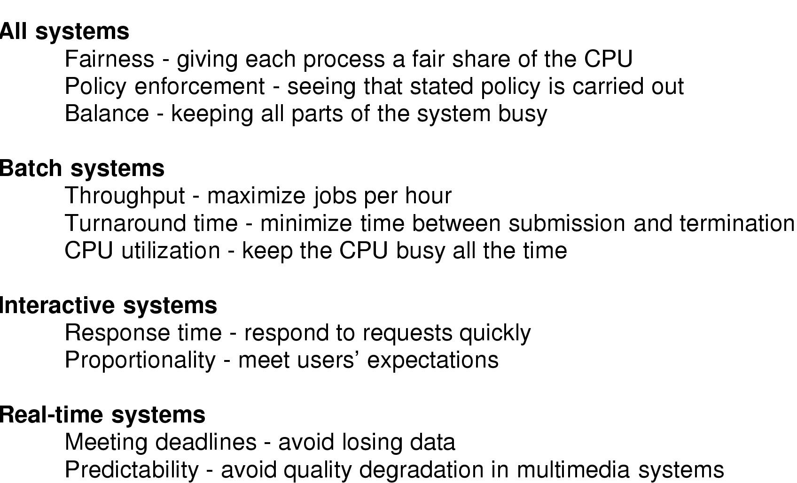
Different Systems, Different Focuses

Slide 13
Batch Systems
Users submit their job to the batch system
Batch system starts user job when appropriate
User gets notification that job is done
No interaction in between
No users impatiently waiting at terminals for a quick response to a short request
Used in business world such as Profit calculation at banks, claims processing at insurance companies…

Slide 14
Batch Systems
Common performance metrics
Throughput: number of jobs completed per hour
Turnaround time: average time between the submission and completion of a job
Maximizing Throughput may not necessarily minimize Turnaround time

Slide 15
Batch Systems
Algorithms used:
Non-preemptive
Preemptive algorithms with long time periods are often acceptable
Reduces process switches and improves performance
Representative algorithms:
First Come First Serve (FCFS)
Shortest Job First
Shortest Remaining Time First

Slide 16
First Come First Serve (FCFS)
Process that requests the CPU FIRST is allocated the CPU FIRST.
Also called FIFO
non-preemptive
Used in Batch Systems
Real life analogy?
Transaction at Sonali Bank
Implementation
FIFO queues
A new process enters the tail of the queue
The schedule selects from the head of the queue.

Slide 17
FCFS Example
Process | Duration | Order | Arrival Time
P1 | 24 | 1 | 0
P2 | 3 | 2 | 0
P3 | 4 | 3 | 0
The final schedule:
P1 (24)
P2 (3)
P3 (4)
0
24
27
P1 turnaround: 24
P2 turnaround: 27
P3 turnaround: 31
The average turnaround: (24+27+31)/3 = 27.33

Slide 18
FCFS Example 2
Process | Duration | Order | Arrival Time
P1 | 24 | 3 | 0
P2 | 3 | 1 | 0
P3 | 4 | 2 | 0
The final schedule:
P2 (3)
P3 (4)
P1 (24)
0
3
7
31
P1 turnaround: 31
P2 turnaround: 3
P3 turnaround: 7
The average turnaround: (31+3+7)/3 = 13.67

Slide 19
Advantage
Easy to understand and implement
Fair for equivalent processes

Slide 20
Problems with FCFS
Non-preemptive
Non optimal turnaround
Cannot utilize resources in parallel:
Assume 1 process CPU bounded and many I/O bounded processes
result: Convoy effect,
low CPU and I/O Device utilization
Why?

Slide 21
Convoy effect
When the CBP uses the CPU
IBPs finish their I/O and move into the ready queue, waiting for the CPU
the I/O devices are idle
When the CBP finally relinquishes the CPU,
CBP moves to an I/O device
the IBPs pass through the CPU quickly and move back to the I/O queues
the CPU is idle
The cycle repeats itself when the CBP gets back to the ready queue

Slide 22
Convoy Effect
Ready Queue
CPU
CPUB
I/O
I/O Queue
I/O Request
IOB
IOB
IOB
CPU is running CPUB

Slide 23
Convoy Effect
IOB
CPU
Ready Queue
CPUB
I/O
I/O Queue
I/O Request
IOB
IOB
CPU is running CPUB

Slide 24
Convoy Effect
IOB
IOB
CPU
Ready Queue
CPUB
I/O
I/O Queue
I/O Request
IOB
CPU is running CPUB

Slide 25
Convoy Effect
IOB
IOB
IOB
CPU
Ready Queue
CPUB
I/O
I/O Queue
I/O Request
CPU is running CPUB
I/O devices idle

Slide 26
Convoy Effect
Ready Queue
CPU
IOB
IOB
I/O
I/O Queue
I/O Request
IOB
CPUB
CPUB moves to I/O device

Slide 27
Convoy Effect
Ready Queue
CPU
IOB
I/O
I/O Queue
I/O Request
IOB
IOB
CPUB
I/O Bound jobs take very small
amount of CPU time and go for I/O

Slide 28
Convoy Effect
Ready Queue
CPU
I/O
I/O Queue
I/O Request
IOB
IOB
IOB
CPUB
CPU idle

Slide 29
Shortest Job First (SJF)
Scheduling algorithm in batch systems
Schedule the job with the shortest run time first
Requirement: the run time needs to be known in advance
SJF is optimal in terms of turnaround, if all jobs arrive at same time

Slide 30
SJF: Example
Process | Duration | Order | Arrival Time
P1 | 6 | 1 | 0
P2 | 8 | 2 | 0
P3 | 7 | 3 | 0
P4 | 3 | 4 | 0
P4 (3)
P1 (6)
P3 (7)
P2 (8)
3
9
16
24
0
Do it yourself
P4 turnaround: 3
P1 turnaround: 9
P3 turnaround: 16
P2 turnaround: 24
Total execution time: 24
The average turnaround: (3+9+16+24)/4 = 13

Slide 31
Comparing to FCFS
Process | Duration | Order | Arrival Time
P1 | 6 | 1 | 0
P2 | 8 | 2 | 0
P3 | 7 | 3 | 0
P4 | 3 | 4 | 0
P1 (6)
P2 (8)
P3 (7)
P4 (3)
0
6
14
21
24
The total time is the same.
The average turnaround: (6+14+21+24)/4 = 16.25
(comparing to 13)
P1 turnaround: 6
P2 turnaround: 14
P3 turnaround: 21
P4 turnaround: 24

Slide 32
SJF is not always optimal
SJF optimal only if all jobs have arrived at scheduling time
Process | Duration | Order | Arrival Time
P1 | 10 | 1 | 0
P2 | 2 | 2 | 2
P1 (10)
P2 (2)
0
2 (p2 arrives)
10
12
The average turnaround (AWT): (10+10)/2 = 10
P1 turnaround: 10
P2 turnaround: 10

Slide 33
Preemptive SJF
Also called Shortest Remaining Time Next
Schedule the job with the shortest remaining time required to complete
When new job arrives, compare its total time with the remaining time of the running job
If the new job needs less time the current job is suspended and the new job started
Requirement: the run time needs to be known in advance

Slide 34
Preemptive SJF: Same Example
Process | Duration | Order | Arrival Time
P1 | 10 | 1 | 0
P2 | 2 | 2 | 2
P1 (2)
P2 (2)
P1 (8)
0
2
4
12
P1 turnaround: 12
P2 turnaround: 2
The average turnaround: (2+12)/2 = 7

Slide 35
Problem with Preemptive SJF?
Starvation
In some condition, a job is waiting for ever
Example: Preemptive SJF
Process A with run time of 1 hour arrives at time 0
But every 1 minute, a short process with run time of 1 minute arrives
Result of Preemptive SJF: A never gets to run

Slide 36
Interactive System
Example: Servers
Serve multiple remote users all of whom are in a big hurry
Performance Criteria
Min response time:
amount of time it takes from when a request was submitted until the first response is produced, not output
respond to requests quickly

Slide 37
Interactive System
Algorithms used here usually preemptive
Time is sliced into quantum (time intervals)
Scheduling decision is also made at the beginning of each quantum
Representative algorithms:
Round-robin
Priority-based
Shortest process time
Guaranteed Scheduling
Lottery Scheduling
Fair Sharing Scheduling

Slide 38
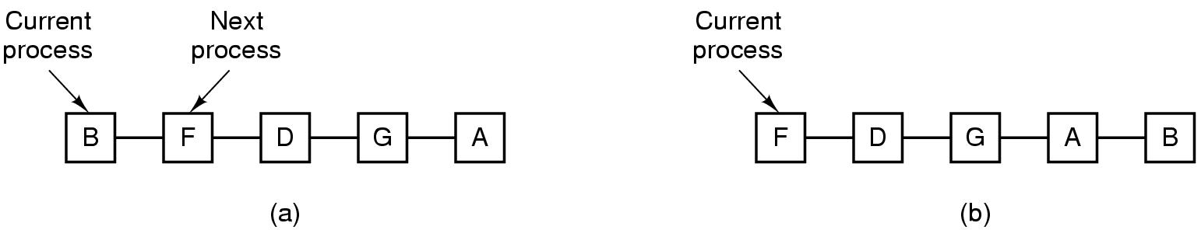
Round Robin
Round Robin (RR)
Often used for timesharing
Each process is given a time slice called a quantum
It is run for the quantum or until it blocks
RR allocates the CPU uniformly (fairly) across participants from ready queue.
Problem:
Do not consider priority
Context switch overhead

Slide 39
Implementing Round Robin
Keep the ready queue as a FIFO queue of processes.
New processes are added to the tail of the ready queue.
The scheduler
picks the first process from the ready queue
sets a timer to interrupt after 1 time quantum, and
Starts the process.
When the quantum is over
The running process will be put at the tail of the ready queue.

Slide 40
RR with Time Quantum = 20
Process Run Time
P₁ 53
P₂ 17
P₃ 68
P₄ 24
All processes arrive at time 0
The Gantt chart is
Higher average turnaround than SJF
But better response time
P₁
P₂
P₃
P₄
P₁
P₃
P₄
P₁
P₃
P₃
0
20
37
57
77
97
117
121
134
154
162

Slide 41
RR: Choice of Time Quantum
Performance depends on length of the timeslice
Context switching isn’t a free operation.
If timeslice time is set too high
attempting to amortize context switch cost, you get FCFS.
i.e. processes will finish or block before their slice is up anyway
Poor response time
If it’s set too low
you’re spending all of your time context switching between threads.

Slide 42
Priority Scheduling
Each job is assigned a priority
Select highest priority job to run next
Rational: higher priority jobs are more important
Example: simulation vs. auto save a document
Problems:
Low priority process may starve
Solution:
Priority need to be adjusted depending on the situation

Slide 43
Assign Priority
Two approaches
Static (for system with well known and regular application behaviors)
Dynamic (otherwise)
Priority may be based on:
Cost to user.
Importance of user
Percentage of CPU time used in last X hours

Slide 44
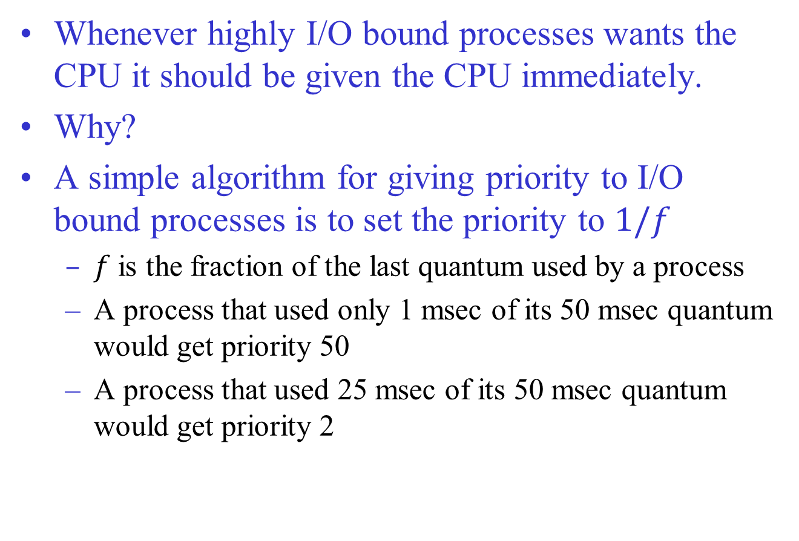
Example: Dynamic Priority Assignment

Slide 45
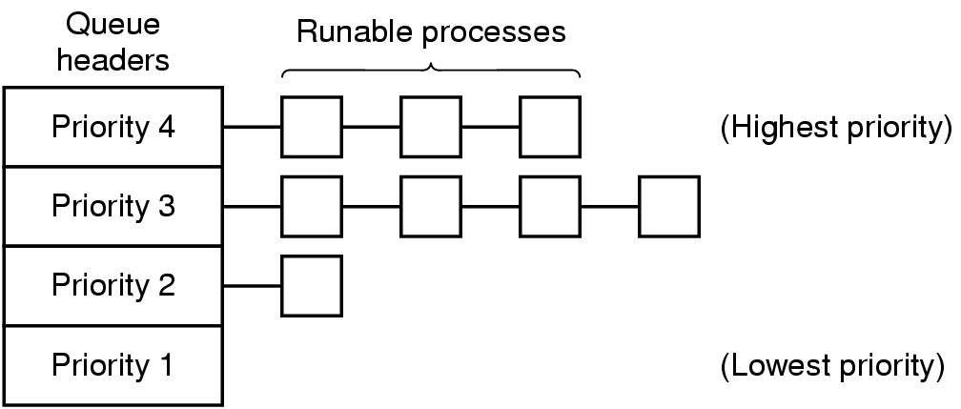
Priority class
It is often convenient to group processes into priority classes and use priority scheduling among the classes but RR within each class
If priorities are not adjusted occasionally, lower priority classes may all starve to death

Slide 46
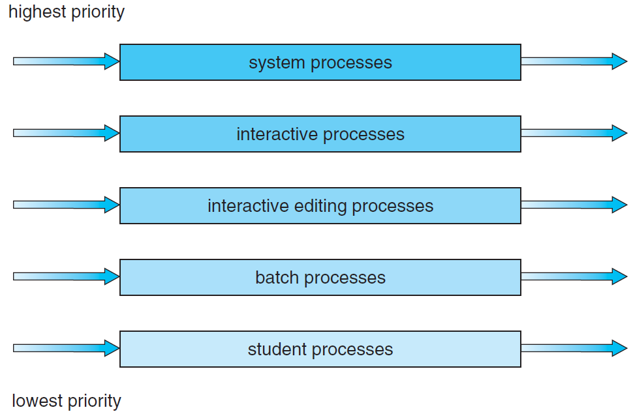
Priority class

Slide 47
Shortest Process Next
Let’s apply SJF for interactive processes
General pattern of a interactive process: CPU burst, I/O burst, …
Let’s regard the execution of each CPU burst as a separate “job”
Now we can minimize overall response time by running the process with shortest “job” first

Slide 48
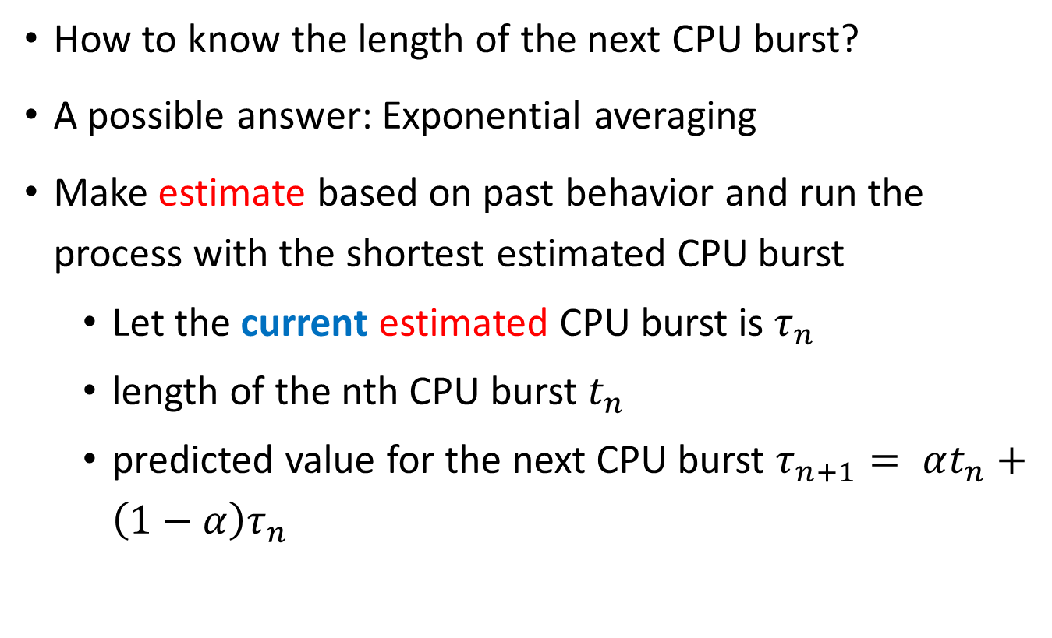
Shortest Process Next
How to know the length of the next CPU burst?
A possible answer: Exponential averaging
Make estimate based on past behavior and run the process with the shortest estimated CPU burst
Let the current estimated CPU burst is $τ_{n}$
length of the nth CPU burst $t_{n}$
predicted value for the next CPU burst $τ_{n+1}= αt_{n}+\left(1−α\right)τ_{n}$

Slide 49
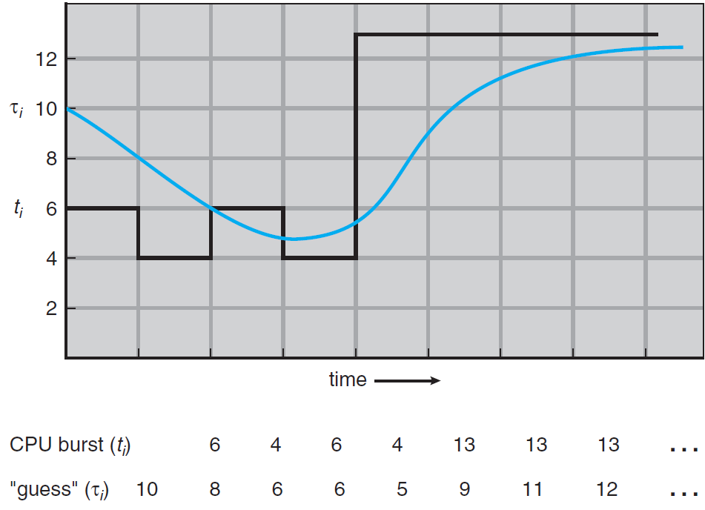
Exponential averaging

Slide 50
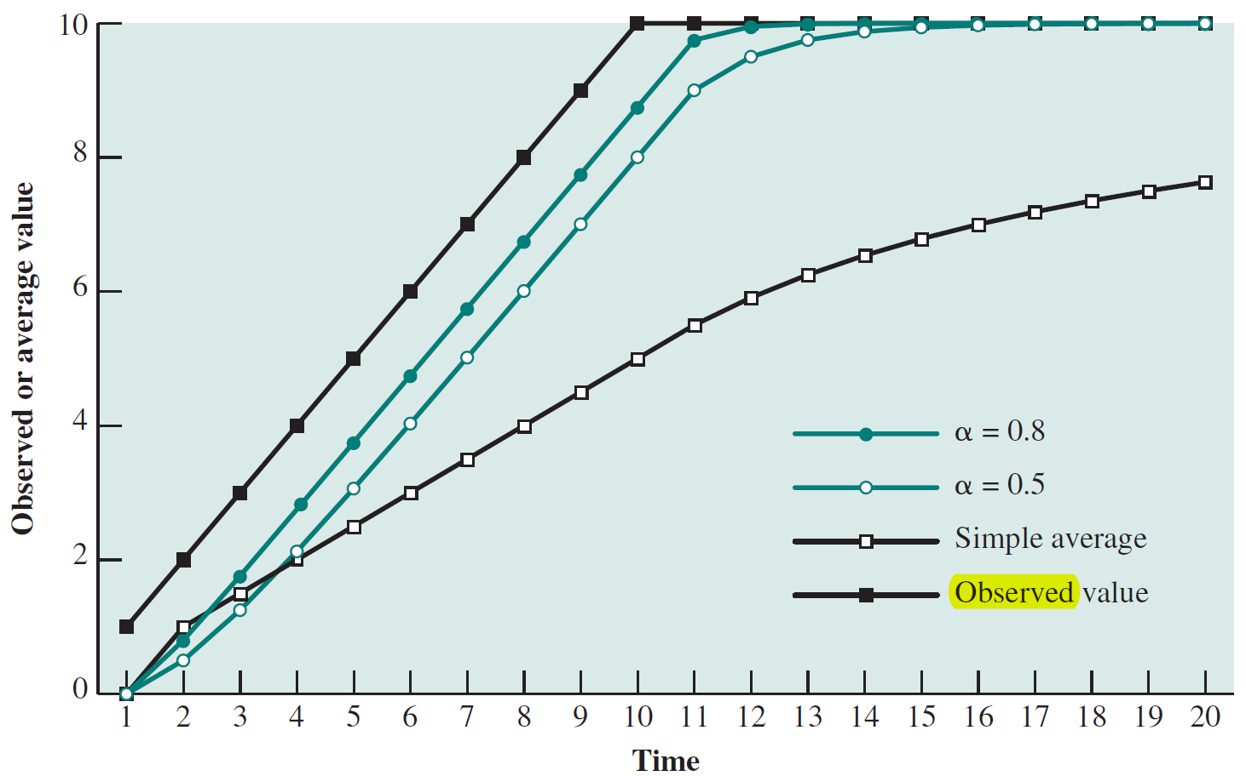
Exponential averaging

Slide 51
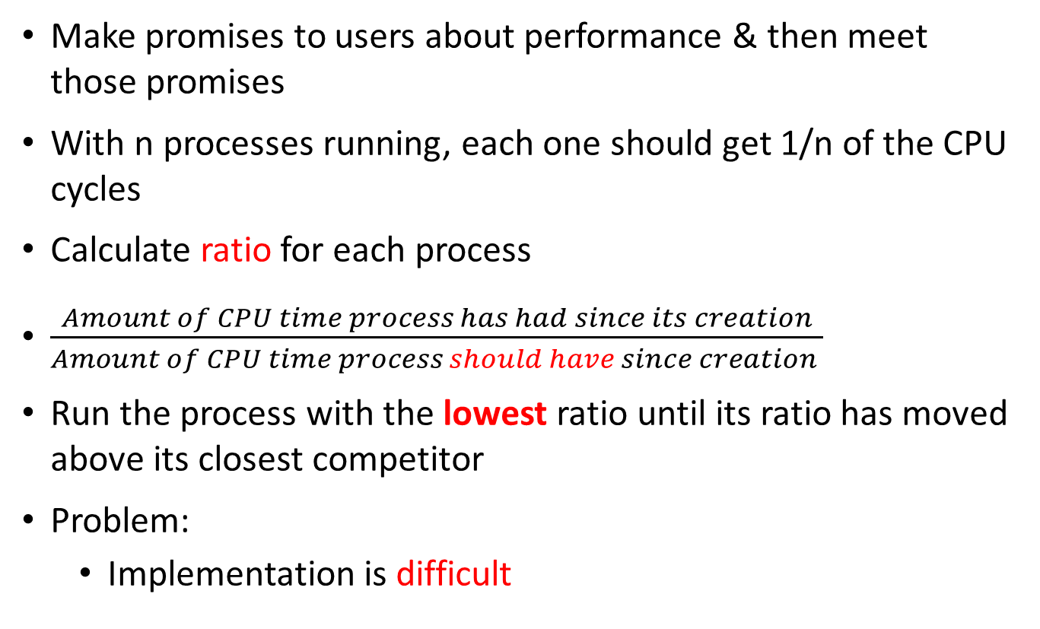
Guaranteed Scheduling
Make promises to users about performance & then meet those promises
With n processes running, each one should get 1/n of the CPU cycles
Calculate ratio for each process
$\frac{Amount of CPU time process has had since its creation}{Amount of CPU time process should have since creation }$
Run the process with the lowest ratio until its ratio has moved above its closest competitor
Problem:
Implementation is difficult

Slide 52
Lottery Scheduling
Give processes lottery tickets for CPU time
Whenever a scheduling decision has to be made, a lottery ticket is chosen at random, and the process holding that ticket gets the CPU
More important processes can be given extra tickets, to increase their chances of winning.
If there are 100 tickets and one process holds 20 of them, it will have a 20% chance of winning each lottery
In the long run, it will get about 20% of the CPU
Highly Responsive:
if a new process shows up and is granted some tickets
at the very next lottery it will have a chance of winning in proportion to the number of tickets it holds

Slide 53
Lottery Scheduling
Cooperating processes may exchange tickets if they wish.
When a chent process sends a message to a server process and then blocks, it may give all of its tickets to the server, to increase the chance of the server running next
After finishing, it returns the tickets so that the client can run again.
Can solve problems that are difficult to handle with other methods
In a video server several processes are feeding video streams to their clients, but at different frame rates.
Let the processes need frames at 10, 20, and 25 frames/sec.
By allocating these processes 10, 20, and 25 tickets, respectively, they will automatically divide the CPU in approximately the correct proportion, that is, 10:20:25.
Notes:
Streaming video is content sent in compressed form over the Internet and displayed by the viewer in real time. With streaming video or streaming media, a Web user does not have to wait to download a file to play it. Instead, the media is sent in a continuous stream of data and is played as it arrives. The user needs a player, which is a special program that uncompresses and sends video data to the display and audio data to speakers. A player can be either an integral part of a browser or downloaded from the software maker's Web site.

Slide 54
Real-Time Systems
Time plays an essential role
Usually the computer must react appropriately to events generated by external devices within a fixed amount of time
patient monitoring in a hospital intensive-care unit,
the autopilot in an aircraft
robot control in an automated factory
Getting right answer but too late == Getting nothing at all
may have catastrophic consequences
financial loss
major equipment damage
loss of life
Notes:
usually dedicated, embedded systems

Slide 55
Real-Time Systems
2 types
Hard real time
Soft real time
Real time behavior is achieved by
Divide the program into a number of predictable, short lived processes
When an external event is detected the scheduler schedules the processes properly to met all deadlines

Slide 56
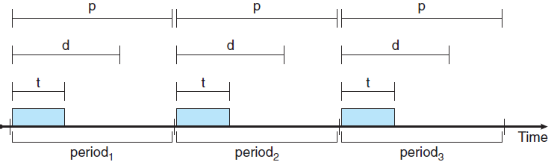
Real-Time Systems
2 types of event
Periodic
aperiodic
A system may have to respond to multiple periodic event streams
It is not always possible to handle all events

Slide 57
Scheduling in Real-Time Systems
Given
m periodic events
event i occurs with period P_{i} and requires C_{i} seconds CPU time to handle
Then the load can only be handled if
A real-time system that meets this criterion is said to be Schedulable

Slide 58
Scheduling in Real-Time Systems
Scheduling algorithm can be
Static: make Scheduling decisions before the system starts running
Need to know about the work to be done and the deadlines to meet in advance
Dynamic: make Scheduling decisions at run time

Slide 59
Thread scheduling
Each process has multiple threads
2 levels of parallelism
Scheduling differs depending on the type of thread support
User-level or Kernel-level?

Slide 60
User-level Thread Scheduling
Kernel is not aware of the existence of threads
Kernel picks a process and thread scheduler inside the process decides which thread to run
Fast Thread switching
Application specific thread scheduler can be used to maximize output
The run time system knows the type of each thread under it

Slide 61
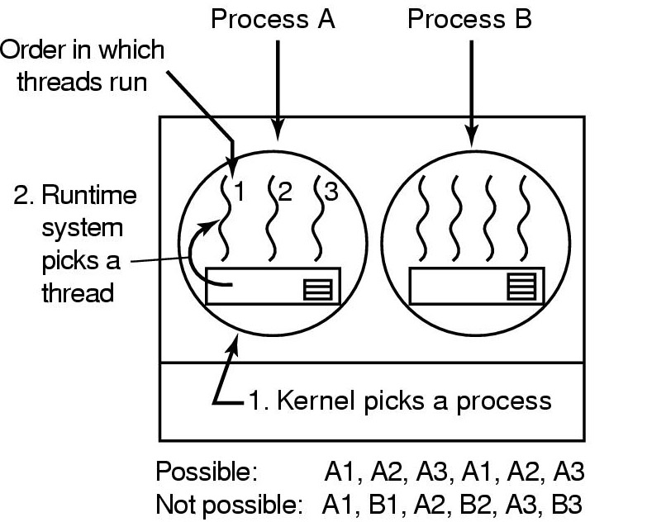
User-level Thread Scheduling
Possible scheduling of user-level threads
50-msec process quantum
threads run 5 msec/CPU burst

Slide 62
Kernel-level Thread Scheduling
Kernel picks a particular thread to run
Having a thread block on I/O does not suspend the entire process
Expensive thread switching

Slide 63
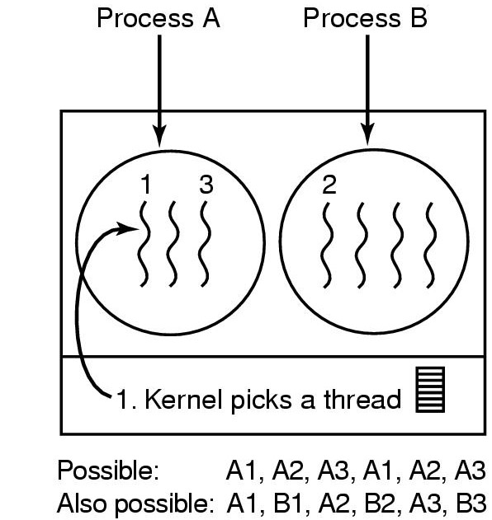
Kernel-level Thread Scheduling
Possible scheduling of kernel-level threads
50-msec process quantum
threads run 5 msec/CPU burst

Slide 64
Thanks For your patience

